Slide 1

Evaluating a Hybrid LSTM-ARIMA Model to Forecast NDXT-100 Performance
Yuca Chen, Jacklyn Clauss, Skyler Lindsey, Dayanara Yanez
PHYS664 Final Presentation | May 15th, 2025
Notes:
Yuca

Slide 2
Table of Contents
Project Description and Motivation
State of the Art in Literature
Data Sources, Cleaning/Integration, Visualizations
Methodological Approach
Results
ARIMA vs. LSTM-ARIMA Prediction
ARIMA vs. LSTM-ARIMA Forecast
Conclusions: Shortcomings of Approach, Lessons Learned
Future Directions
Project Roles, References
Notes:
Yuca

Slide 3

Project Motivation
Average person’s interest in stock market has increased over the past few decades [1]
Technology sector is poised for growth for the rest of this decade [2]
Machine learning techniques can help make more accurate predictions [3]
Most people would like to make money!
Notes:
Yuca

Slide 4


Project Description
How well can an LSTM-ARIMA model forecast the performance of NDXT-100?
Notes:
Yuca
I put in the photos for fun, debating whether or not to keep them (will probably get rid of them) - Yuca

Slide 5
State of the Art in the Literature
Initial studies with regression, but lots of recent studies have used [4, 5]:
Artificial neural networks (ANN)
Support vector machines (SVM)
Long short term memory recurrent neural networks (LSTM RNN)
Range of different datasets have also been called upon to feed into these algorithms
i.e. time-series data of available stock price information, macroeconomic information [3]
Notes:
Skyler

Slide 6
Data Sources
NDXT-100: Main Dataset
NASDAQ-100 Technology Sector
An equal weighted index comprised of securities that are considered to be technological
 | Data Type | Number of Entries | Number of Valid Entries
Trade Date | DateTime | 4803 | 4802
Index Value | Float | 4803 | 4802
Net Change | Float | 4803 | 4802
High Price | Float | 4803 | 4802
Low Price | Float | 4803 | 4802
Notes:
Jacklyn

Slide 7
Auxiliary Data Sources
AAPL and GOOGL Historic Stock Data:
Stock data from Apple and Google
Features include Date, Close/Last Price, Volume Traded, Open Price, High Price, Low Price
Data ranges from March 2015 to March 2025 (10 year time span)
CPI data:
Consumer Price Index → proxy for inflation rate
Data available monthly from March 2015 to March 2025 (10 year time span)
Notes:
Jacklyn

Slide 8
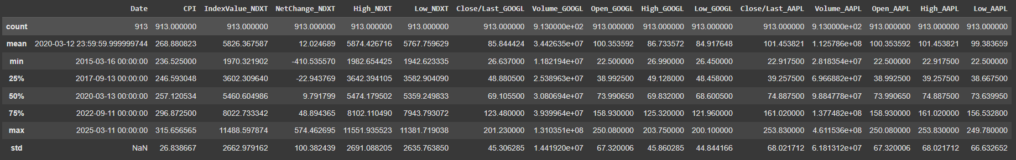
Data Cleaning and Integration
Bring together all four separate datasets into one pandas DataFrame
Unify all datasets under the same dates: 03/16/2015 – 03/11/2025
Impute CPI data to each time step linearly
NOTE: data is not provided every day (weekends, federal holidays, etc. are not included as the NYSE is closed)
The most common interval between data points is four days - use this as our time step for our data
Sample a data set with uniform time step of four days - impute linearly where needed
Figure 1: A snapshot of the pandas command “df.describe()” on the main data frame after reconfiguring the data to have one data point every four days. The total count of data points, mean, standard deviation, minimum value, 25th percentile, 50th percentile, 75th percentile, and maximum value for each data column in the pandas dataframe is printed.
Notes:
Jacklyn

Slide 9
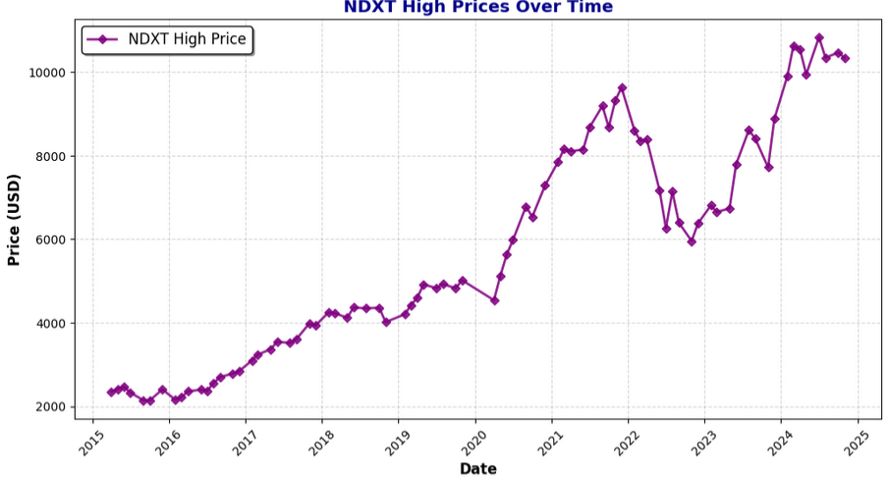
Data Visualizations
The NDXT index shows a strong long-term upward trajectory.
2015–2018: Gradual increase
2024–2025: Stabilization above 10,000
2019–2021: Sharp surge
Figure 2: Trends in NDXT-100 are illustrated, emphasizing the long-term upward movement of the NASDAQ Tech Index.
Notes:
Daya

Slide 10
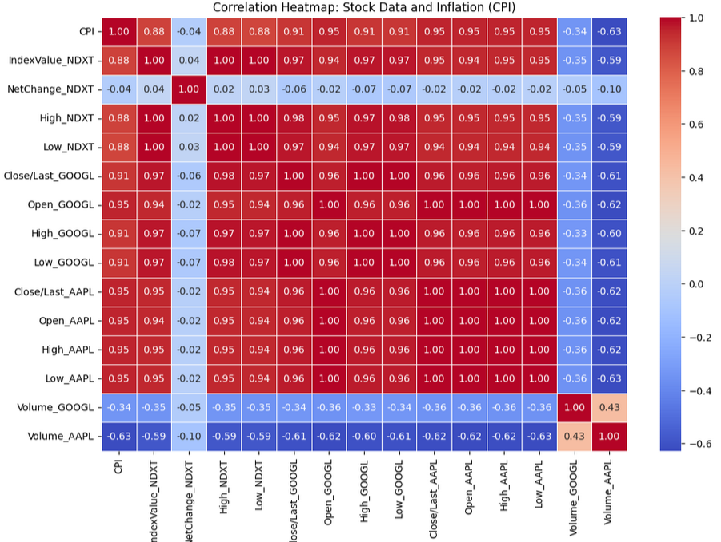
Data
Visualizations
(cont.)
CPI vs. Stock Prices: A strong positive correlation (>0.90)
Trading Volume vs. Stock Prices: Negative correlation
NDXT vs. Stock Prices: NDXT is highly correlated with AAPL and GOOGL
Figure 2: The correlation matrix of all included datasets,
highlights the interdependence between inflation, stock market movements, and trading behaviors.
Notes:
Daya

Slide 11
Proposed Methodology
Why the LSTM + ARIMA Approach?
LSTM excels in identifying complex patterns but may struggle with capturing overall linear trends
ARIMA provides error correction and enhances robustness against volatility and is good with linear trends
Combining both models allows us to improve accuracy in predicting stock market behavior by capturing both local non-linear and global linear trends
Notes:
Skyler

Slide 12
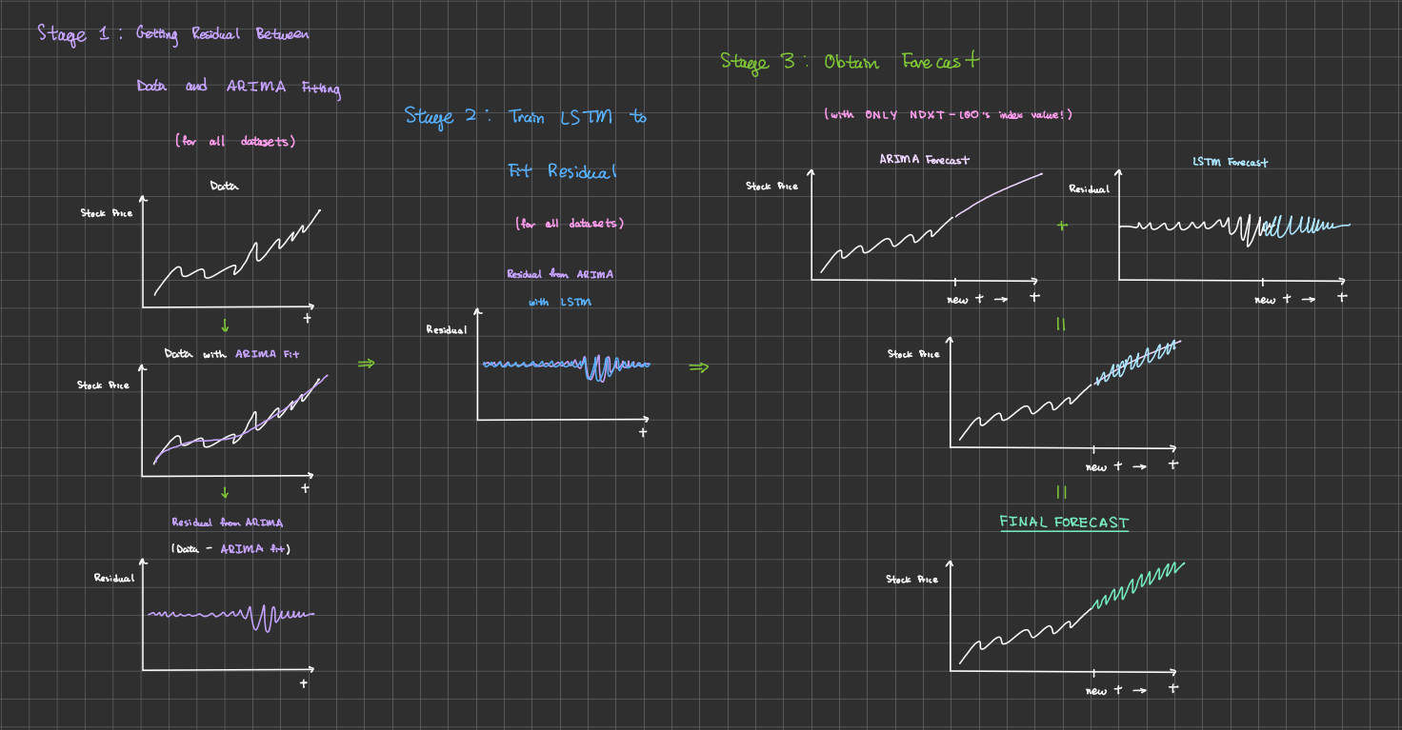
Insert some diagram of fitting process??
I will clean up the diagram I have and insert it here! - Yuca
Notes:
Yuca
Aim time:

Slide 13
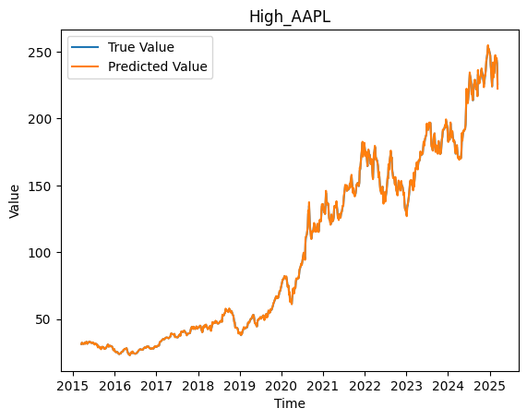
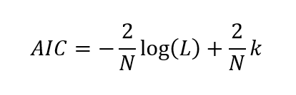
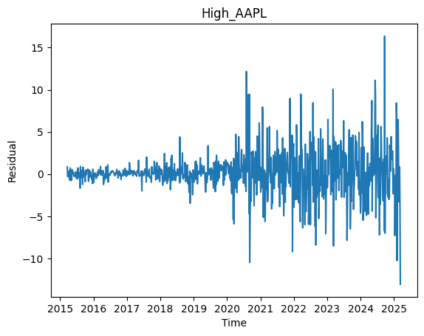
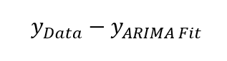
Proposed Methodology:
ARIMA Fitting, Residuals
Akaike Information Criterion (AIC) used to establish the best ARIMA hyperparameters of p, q for each time series
Stationarity test done on each time series
ARIMA fitting then done for each time series
Residual found using
Figure 3: (Top graph) ARIMA fit to Apple high index price data as a function of time. (Bottom graph) Residual from ARIMA fit to the same data as a function of time.
Notes:
Yuca
p (lag order: # of lag observations in the AM model), q (order of moving average: the size of the moving average window)
L is likelihood of the data, k is the number of parameters, N is the number of variables

Slide 14
Proposed Methodology: LSTM Setup
Input data: all residuals from ARIMA, for all time series
Training/testing split: 80/20
Done sequentially to preserve order of data/fulfill forecast purpose
Training and testing are segmented into sub-arrays when input for LSTM to learn segments of data sequentially
Other information:
Training
Test
Time
Activation | Loss | Validation Split | Epochs | Batch Size
ReLu | MSE | 0.1 | 50 | 10
Notes:
Daya
ReLu: y = 0 when x < 0, y = x when x >= 0
Tested different setups, but difficult (mention this briefly during pres.)

Slide 15
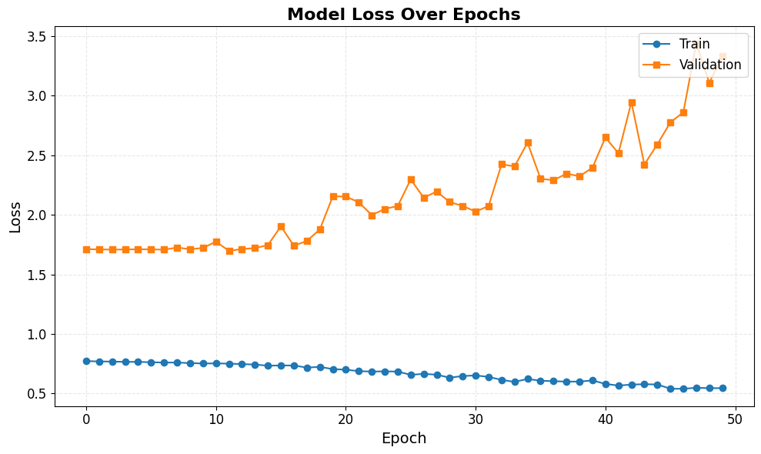
Results: Training LSTM on ARIMA Residuals
Validation loss did not decrease
Tried different training setups, did not improve
Residual structure exploration done, residuals appear to be random noise – hard to model!
Figure 5: The training and validation loss over epochs.
Notes:
Daya
Mention out loud to audience that can bring up residual structure notebook for further questions if want during Q&A session!

Slide 16
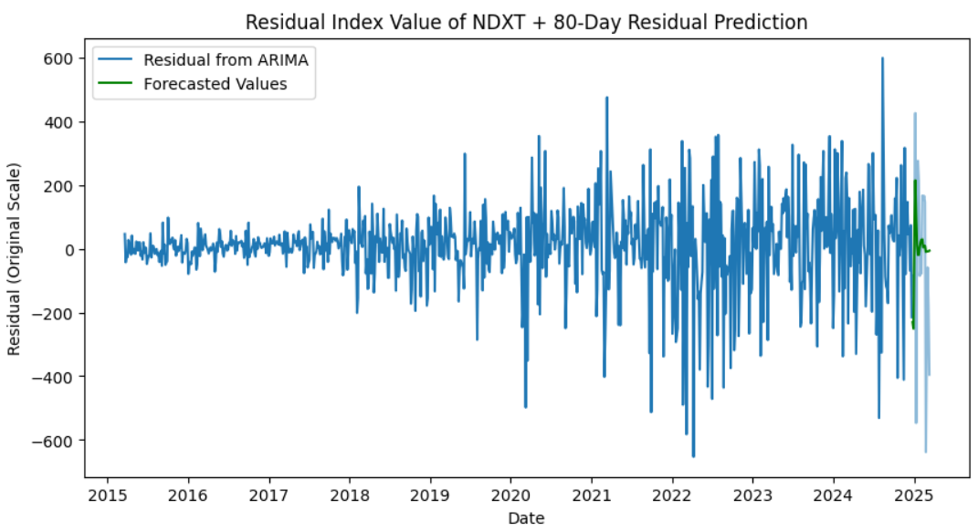
Results: LSTM Residual Prediction
Made for the final 80 days of the known time series
Want to forecast 80 days into the future
Difficulty in modeling random noise + previous behavior hovering around zero → not completely unexpected predicted behavior!
Some initial noise predicted, but then trends towards zero
Figure 6: The residual for the index value of NDXT-100 with the 80-day prediction at the end of the available time series.
Notes:
Daya
Talking notes: despite validation loss, get some noise but clearly then fizzles out to zero
Residual hovers around zero, so would make sense it goes to zero

Slide 17
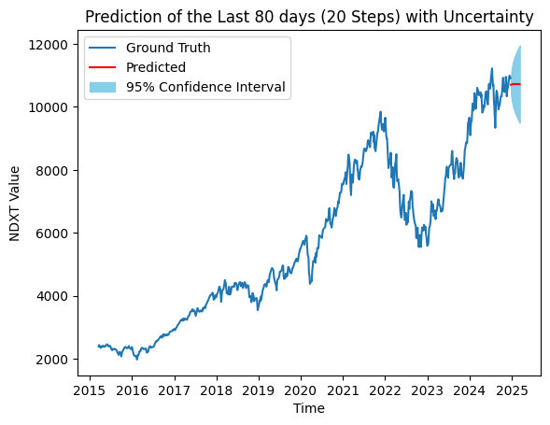
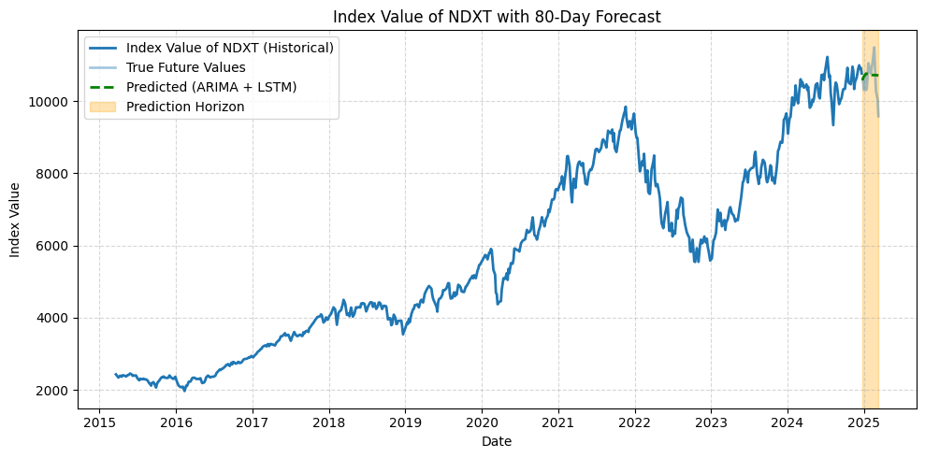
Results: ARIMA, Joint LSTM-ARIMA Prediction
Index Value of NDXT with 80-Day Prediction
ARIMA-only
ARIMA + LSTM Residual
Date
Date
Figure 7: (Left graph) The index value of NDXT-100 with an ARIMA prediction for the last 80 days.
(Right graph) The index value of NDXT-100 with an LSTM-ARIMA prediction for the last 80 days.
Joint LSTM-ARIMA prediction does not perform better than the ARIMA-only prediction!
 | ARIMA-only | ARIMA + LSTM
MSE of 80 day prediction | 2.03 · 10⁵ | 2.07 · 10⁵
*Values in this data set are very large,
causing the mean squared error to be very large
Notes:
Jacklyn

Slide 18
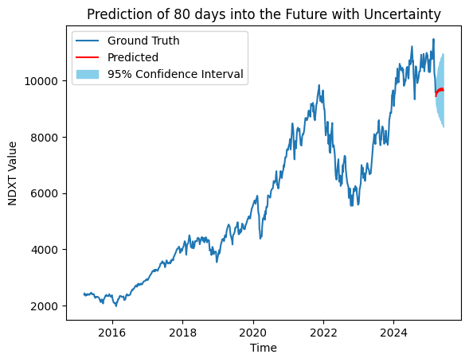
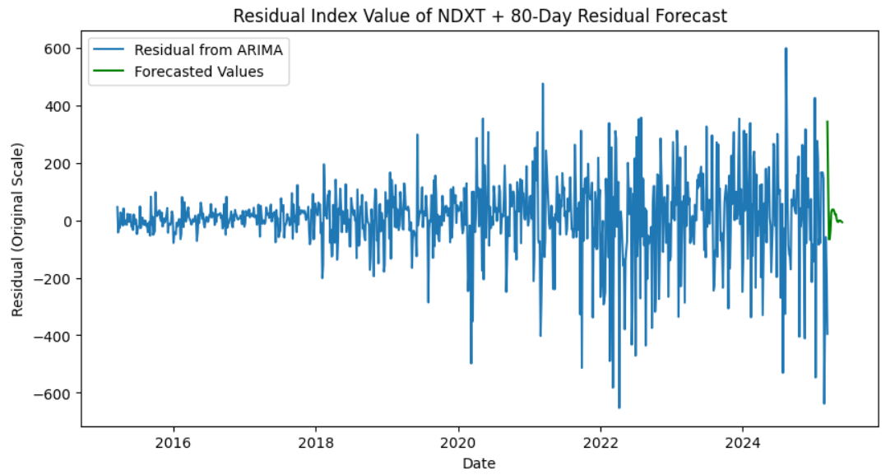
Results: ARIMA, Joint LSTM-ARIMA Forecast
Date
Figure 8: (Left graph) The index value of NDXT-100 with an ARIMA forecast for the next 80 days.
(Right graph) The index value of NDXT-100 with an LSTM-ARIMA forecast for the next 80 days.
Index value forecasted to rise slowly, 80 days into the future
Adding LSTM-forecasted residual to ARIMA forecast has negligible improvement compared to ARIMA-only forecast due to previous results
Notes:
Yuca

Slide 19
Conclusions: Shortcomings/Lessons Learned
ARIMA is too good at its job
There is no structure in the residuals for the LSTM to learn and model
Residuals look like random noise, which cannot be predicted by any model
LSTM does not significantly improve the predictions made by ARIMA
Notes:
Jacklyn

Slide 20
Future Directions:
Make the ARIMA fit worse
Change the ARIMA hyperparameters in order to create residual plots in hopes of getting more structure (example on next slide!)
Include more data
News headline data with sentiment analysis – very, very complicated!
More varied stock data (i.e. materials index data that is used commonly in tech sector)
More macroeconomic information
Incorporating technical indicators (i.e. more quantitative analysis on historical price data before inputting data)
Notes:
Skyler
For including more data:
More news
This is very complicated
People get hired to do this as their full time job

Slide 21
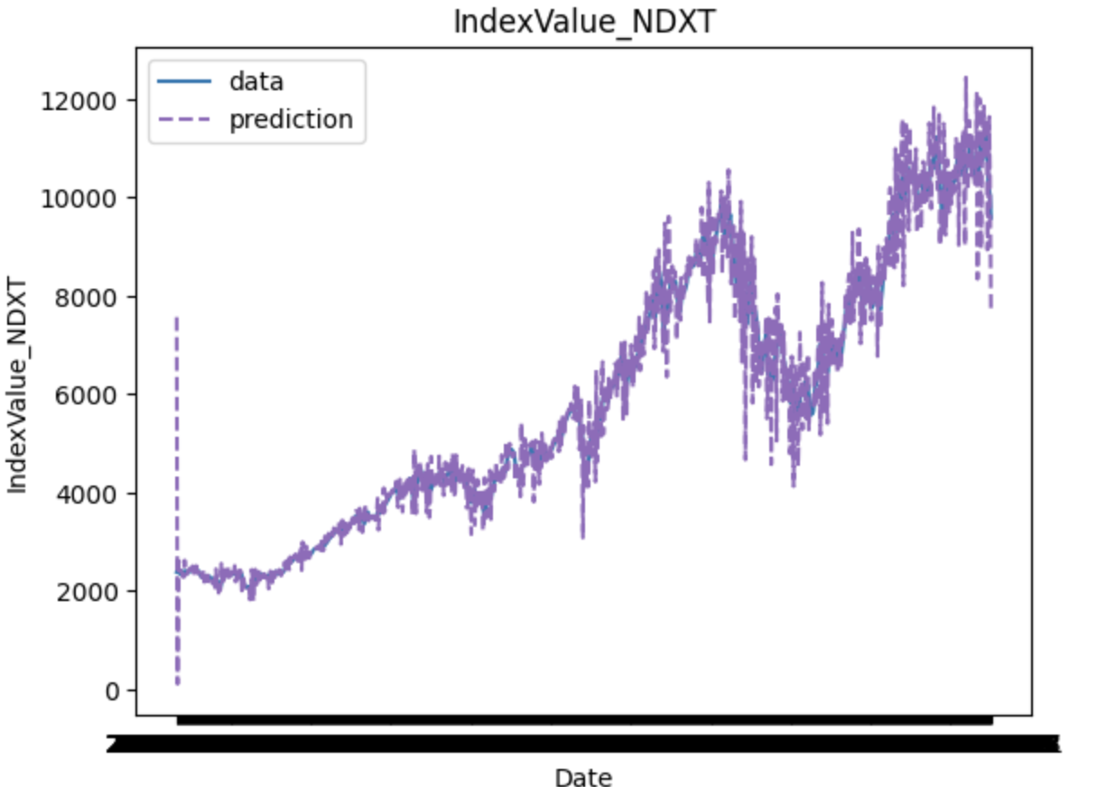
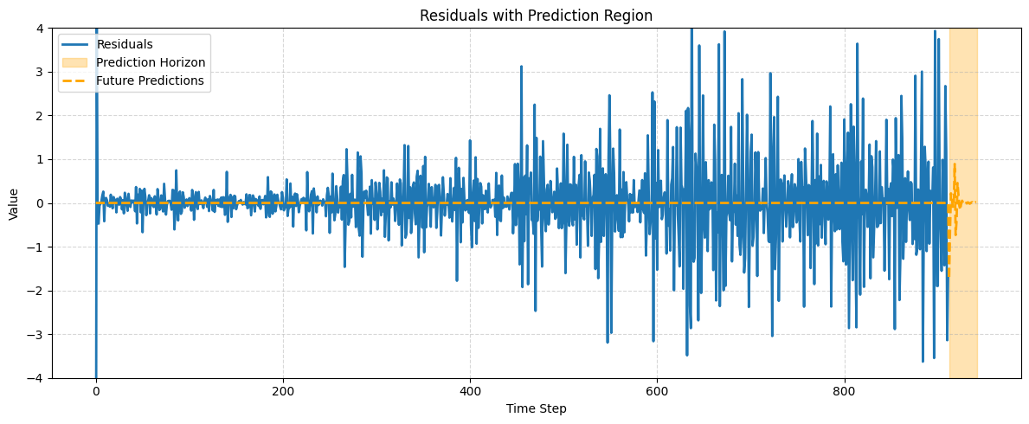
Future Directions:
An Example of Forecasting LSTM Residual from a Worse ARIMA Model
Figure 9: The index value of NDXT-100 with an poor ARIMA fit.
Even with worse ARIMA, more work may need to be done to separate out any structural behavior from residuals better!
Figure 10: The LSTM forecast 80 days into the future with a worse ARIMA residual as input data for the index value of NDXT-100 as a function of timestep. Residuals shown are standardized residuals.
Notes:
Skyler

Slide 22
Acknowledgements
Huge thank you to Professor Bianco
for her invaluable help during this project!
✨🥹✨
Notes:
Yuca

Slide 23
Project Points of Contact
Data Manager | Jacklyn Clauss
Communication Manager | Yuca Chen
Analysis Manager | Yuca Chen, Skyler Lindsey
Visualization Manager | Dayanara Yanez
Literature Manager | Skyler Lindsey
Notes:
Yuca

Slide 24
References
[1] Badolia, Lokesh. How can i get started investing in the stock market. Educreation Publishing, 2016.
[2] Fineberg, Steve, Susanne Hupfer, Michael Steinhart, Sayantani Mazumder, and Prashant Raman. “2025 Technology Industry Outlook.” Deloitte Insights, April 21, 2025. https://www2.deloitte.com/us/en/insights/industry/technology/technology-media-telecom-outlooks/technology-industry-outlook.html.
[3] Kumbure, Mahinda Mailagaha, Christoph Lohrmann, Pasi Luukka, and Jari Porras. "Machine learning techniques and data for stock market forecasting: A literature review." Expert Systems with Applications 197 (2022): 116659.
[4] Mintarya, Latrisha N., Jeta NM Halim, Callista Angie, Said Achmad, and Aditya Kurniawan. "Machine learning approaches in stock market prediction: A systematic literature review." Procedia Computer Science 216 (2023): 96-102.
[5] Liu, Yang. "Novel volatility forecasting using deep learning–long short term memory recurrent neural networks." Expert Systems with Applications 132 (2019): 99-109.
Notes:
Yuca

Slide 25
Additional Slides

Slide 26
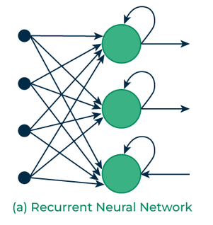
Methodological Approach
Techniques Used:
Long Short-Term Memory (LSTM)
A type of recurrent neural network that is effective in capturing long-term dependencies and non-linear trends in time series data
Autoregressive Integrated Moving Average (ARIMA)
A statistical model designed for handling non-stationary time series data and capturing linear trends
[6]

Slide 27
Data Sources (cont.)
CPI data - Supplemental Dataset
Consumer price index → proxy for inflation rate
Available monthly
Note that this data set is organized with the year as the row and the month as the column
Because of this, the 2025 row is “missing” data for March onward, as that data is not yet available
 | Data Type | Number of Entries | Number of Valid Entries
CPI | Float | 422 | 422
Notes:
Jacklyn

Slide 28
Data Sources (cont.)
AAPL Historic Stock Data and GOOGL Historic Stock Data: Supplemental Dataset
Apple Stock Data
Google Stock Data
 | Data Type | Number of Entries | Number of Valid Entries
Date | DateTime | 2517 | 2517
Close/Last Price | Float | 2517 | 2517
Volume | Integer | 2517 | 2517
Open Price | Float | 2517 | 2517
High Price | Float | 2517 | 2517
Low Price | Float | 2517 | 2517
Notes:
Jacklyn

Slide 29
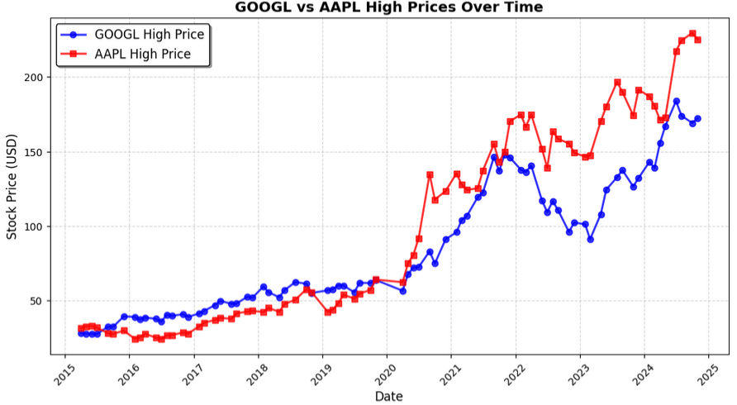
Data Visualizations
Both stocks exhibit a general upward trajectory despite periodic fluctuations.
2022–2023: AAPL experiences higher volatility compared to GOOGL.
2019–2021: AAPL outperforms GOOGL.
Figure 11: Trends are boxed off, highlighting fluctuations and performance differences over time.
Notes:
Daya

Slide 30
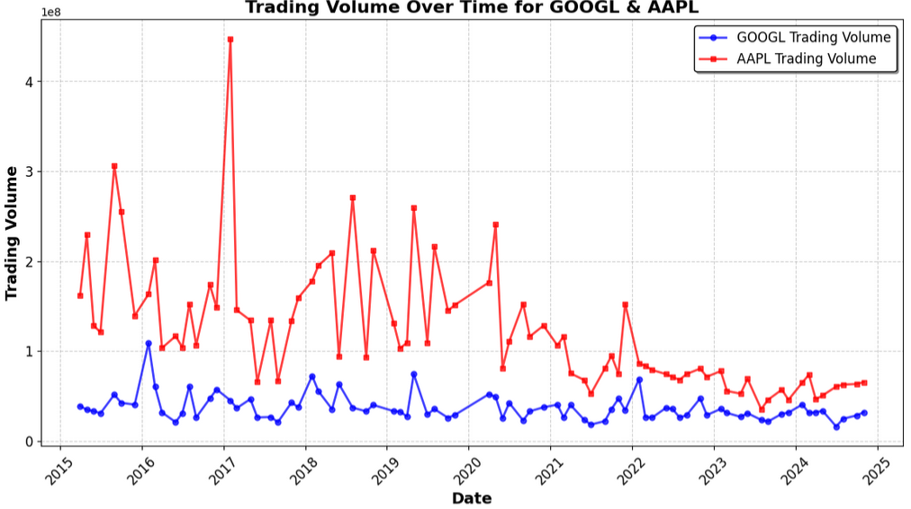
Data Visualizations (cont.)
Both stocks demonstrate upwards and/or stable trading behavior.
2018–2021: AAPL fluctuates but generally high trading activity, while GOOGL remains relatively stable.
2022–2025: Stable
2015–2017: increased market activity.
Figure 12: The differences in trading activity between AAPL and GOOGL are highlighted, providing insights into investor behavior and market liquidity over time.
Notes:
Daya

Slide 31
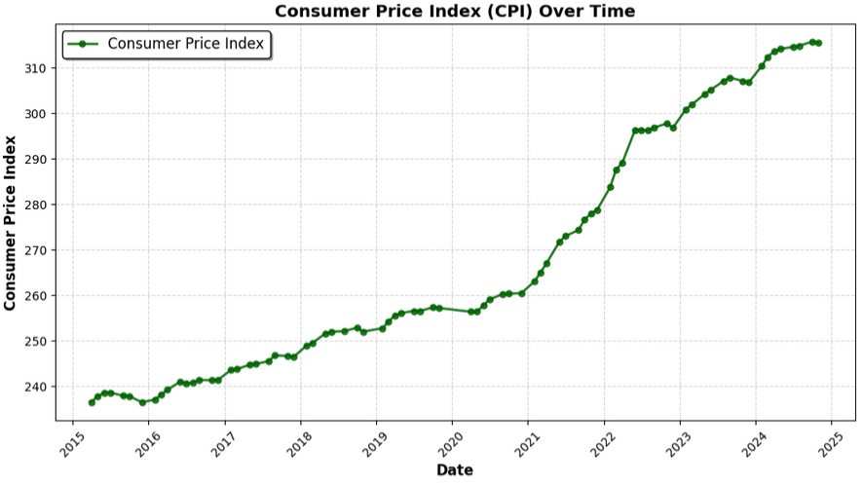
Data Visualizations (cont.)
The CPI shows a steady increase, reflecting rising costs of goods and services over time.
2021 Onward: Acceleration in inflation, indicating a period of increased economic pressure
2015–2020: Gradual inflationary trend.
Figure 13: CPI values on the y-axis and years on the x-axis, highlighting the impact of inflation over time
Notes:
Daya

Slide 32
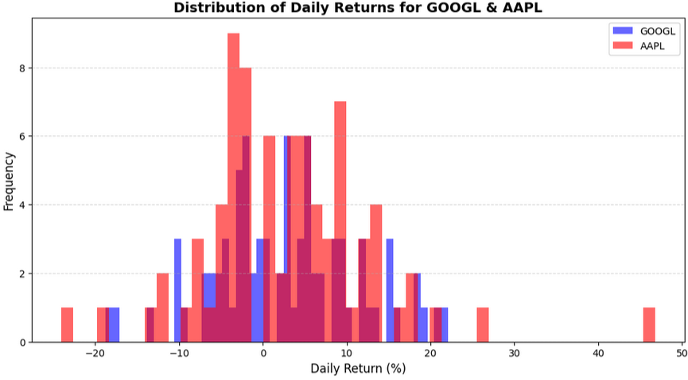
Data Visualizations (cont.)
Bell-shaped distribution,
stability on most trading days
Significant price swings, highlighting periods of high market volatility.
Figure 14: Histogram of daily returns (%) for AAPL (red) and GOOGL (blue) over a specified period.
Both stocks exhibit similar return patterns, though AAPL shows slightly more extreme fluctuations in both directions.
Notes:
Daya

Slide 33
Proposed Methodology (cont.)
Based on methodology from Kashif and Ślepaczuk (2024) [5]:
Perform an ARIMA analysis
Use the residual plot from the ARIMA model alongside collected data to develop features in LSTM model
Hyperparameter turning for the LSTM model
MCMC for hyperparameters? Other testing methods?
Fit model using tuned hyperparameters and obtain predication
Notes:
Skyler

Slide 34
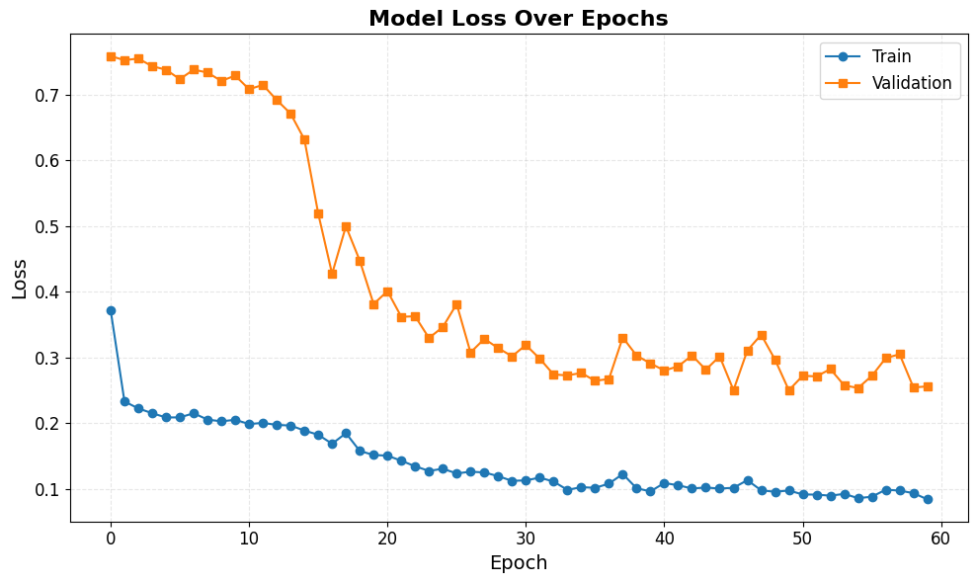
“Worse ARIMA” Model Loss
Figure 15: The training and validation loss over epochs.

